Slide 1
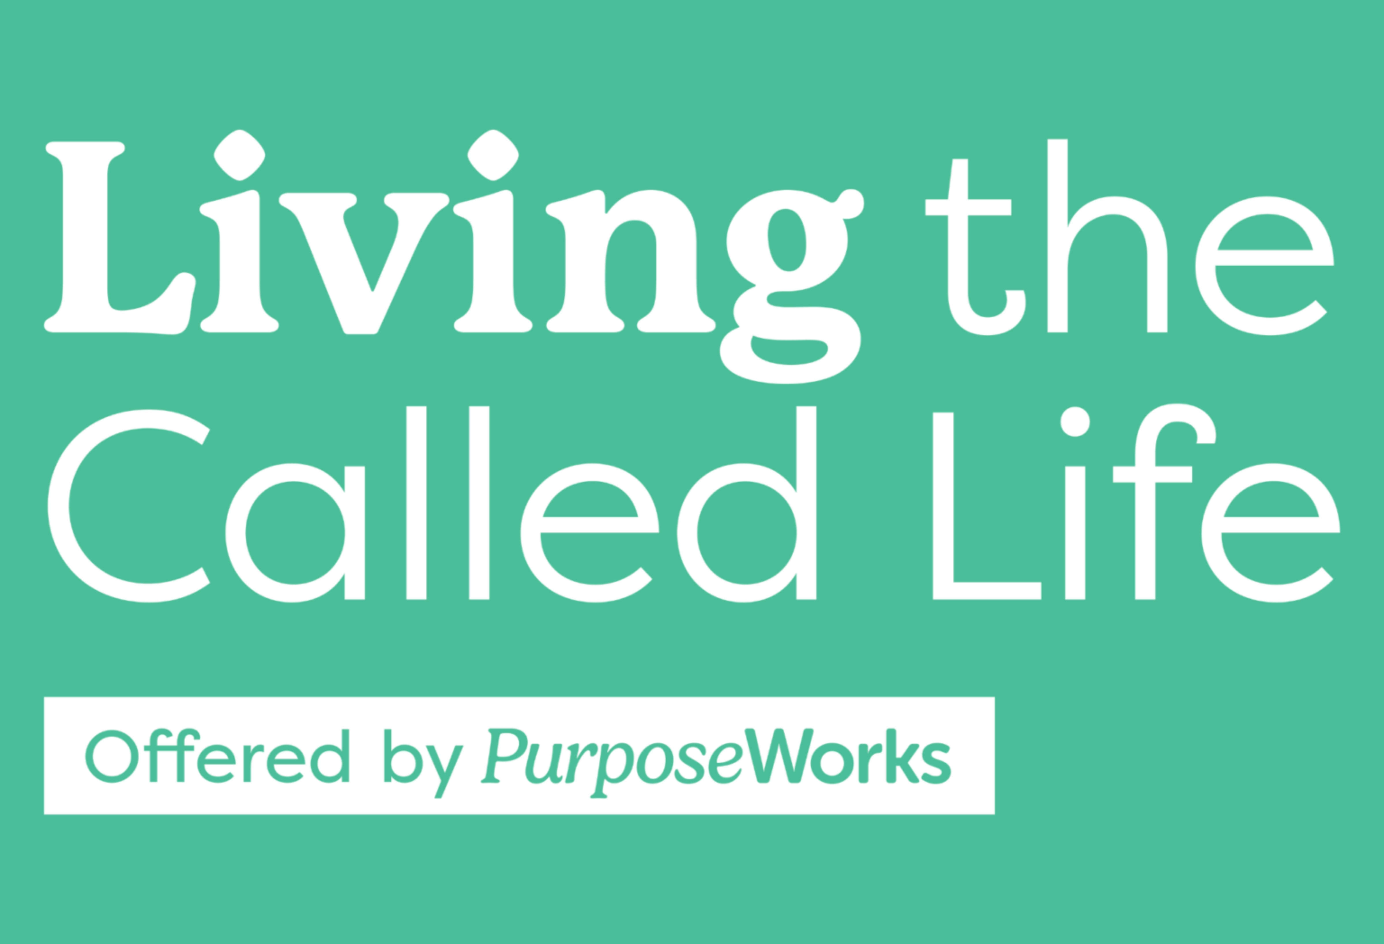
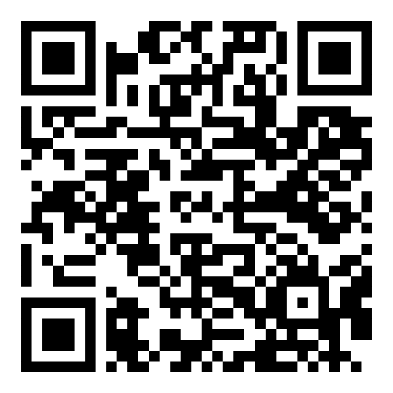
Living The Called Life Workshop starts {date}!
{night – time}PM, 8 sessions
Location / Building
DISCOVER LIFE PURPOSE & WORK/LIFE BALANCE
Find out how God has uniquely designed you — and step into the joy of living out His calling.
Key Outcomes:
Recognize where God is moving and learn how to join Him every day.
Uncover your unique gifts and wiring and see how they point to your God-given mission.
Live with purpose, right where you are — whether you’re navigating a new season or staying faithful in your current one.
Craft a personalized Life Mission & Purpose Statement and develop a Work-Life Balance Plan aligned with your calling.
Interested in Participating?
Join us for this live, interactive workshop, and learn how to apply these key concepts in community!

