Slide 1
Working for the State of Texas
Pro’s and Con’s
Pros
Work – Life Balance – (Quote our Commissioner)
Collegial atmosphere – (How can I help you succeed)
Benefits- Retirement plus Medical (Rule of 80)
Hire to the Busiest Day vs. Slowest Day
At work fitness activities – Gym, vball and bball courts, walking trails, etc.
Networking NOT Needed (well…a little)
Resume’s not important (well…to help you fill out application)
Cons
Advancement can be slow
Starting salary and time-off are non-negotiable
Comparable “title” would pay more in private sector (but you would work more to get it)
Needed process changes can be painstaking to get implemented
Seniority is more valued than ability (up for debate)
Following the process is more important than the result

Slide 2
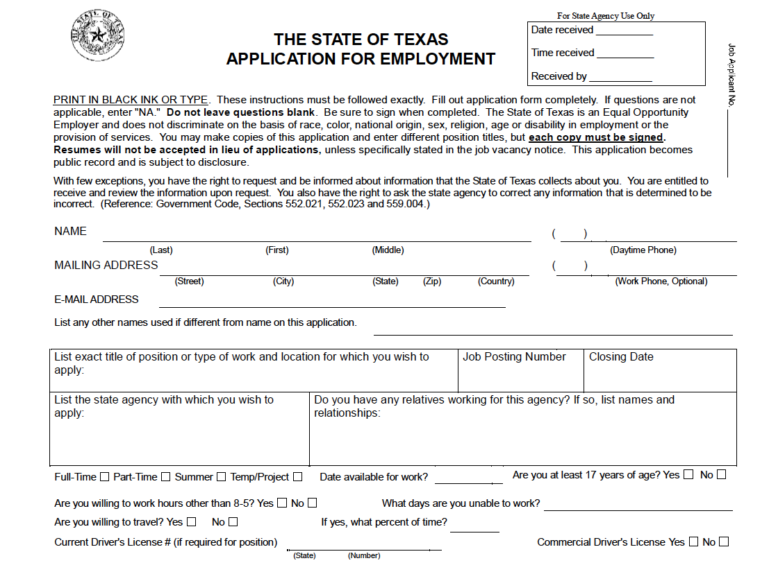

Slide 3
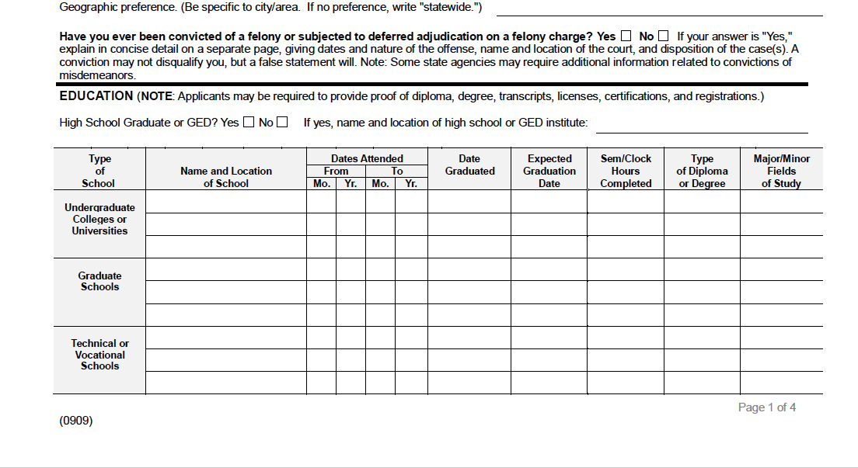

Slide 4
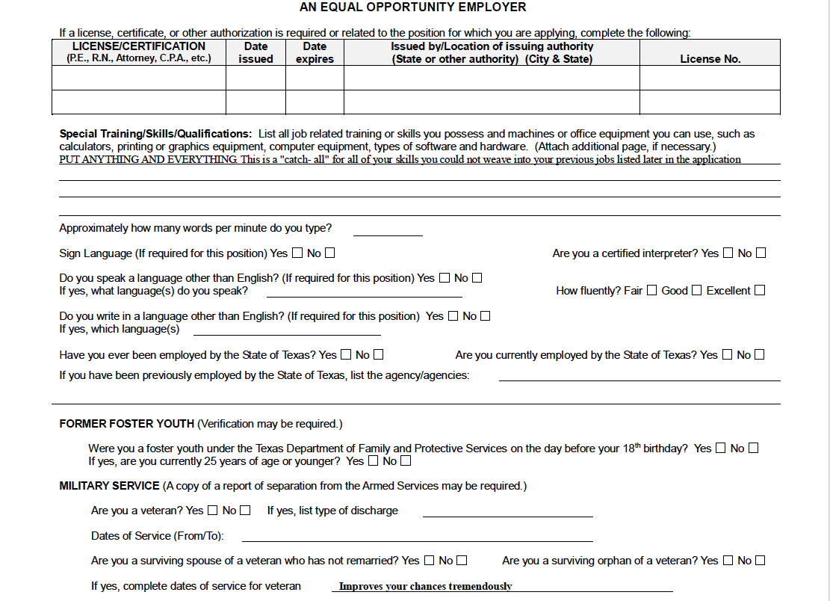

Slide 5
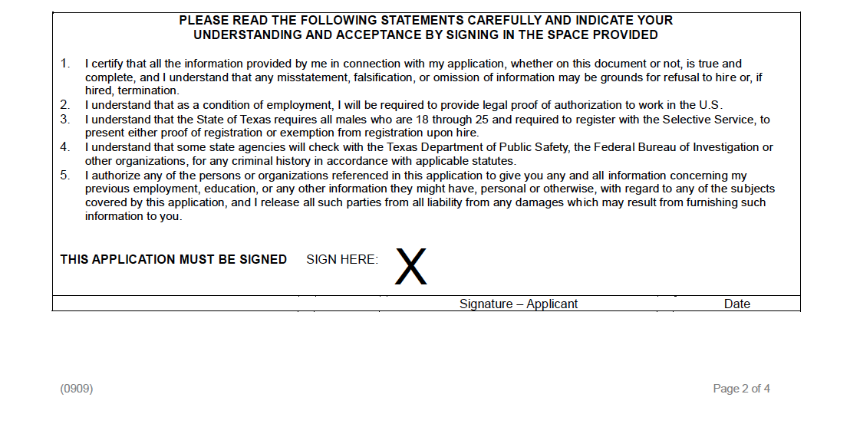

Slide 6
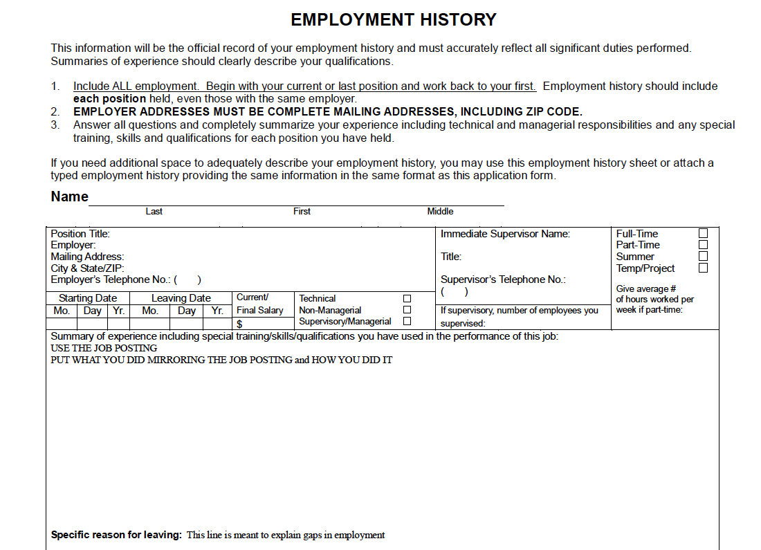

Slide 7
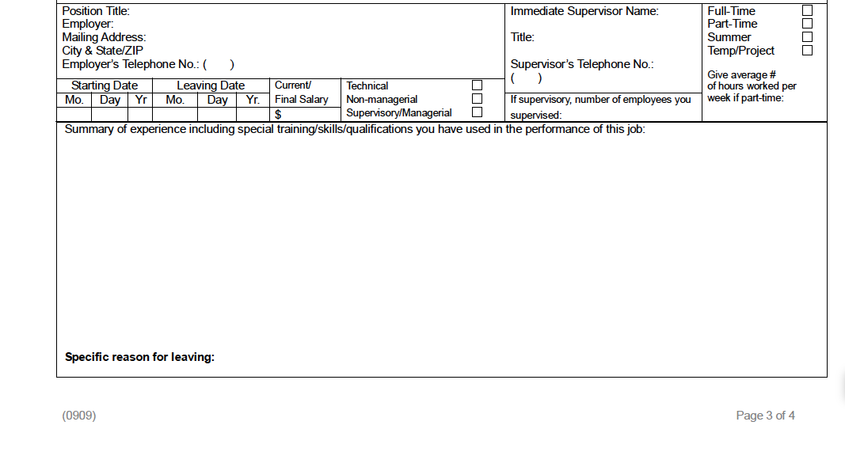

Slide 8
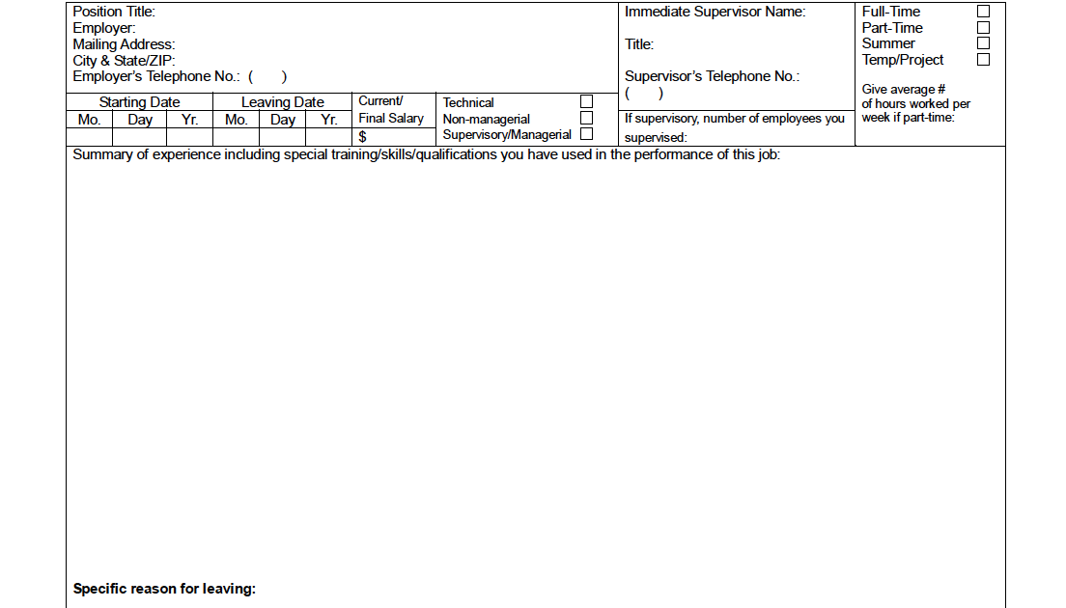

Slide 9
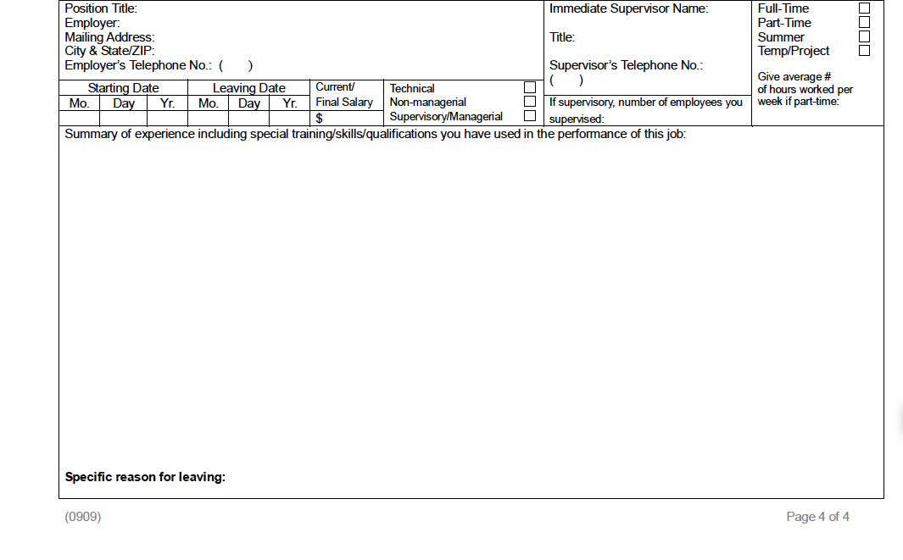

Slide 10
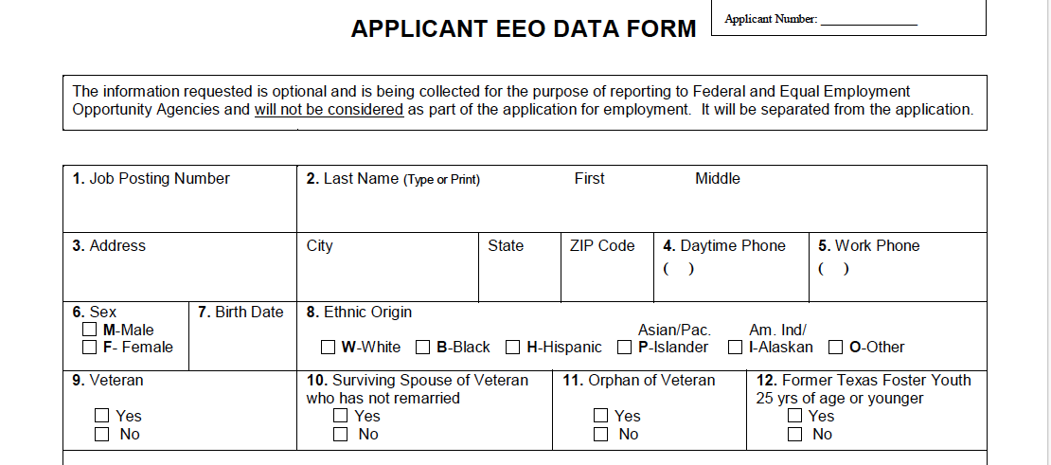

Slide 11
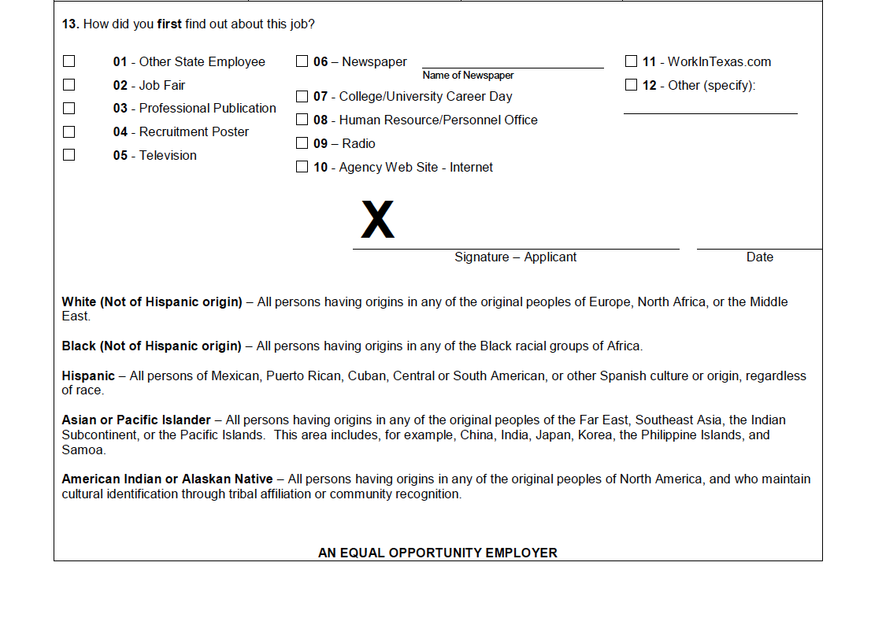

Slide 12
State Application
Scored by Robots; well, not really, but close
Plagiarize; don’t lie, but plagiarize
Copy and paste from the Job posting
Tell what you have done and how you have done it
Use white space; but otherwise, use all the space
If you have a 4 year degree and/or advanced degree, add transcript to application
Give me reasons to trust you; not mistrust you
If you are adding something that raises an eyebrow, or leaving something out…
Better explain it because I do not know you yet

